Slide 1
NoteShare System Architecture
Nathan Denklau
Nathan Fritze
Joe Trapani
Jonathan Hall
Satpreet Singh

Slide 2
Presentation Overview
High-Level System Architecture
Component Overview
Component Level View/Interfaces
Sequence Diagrams
ER Diagram
Mock-ups

Slide 3
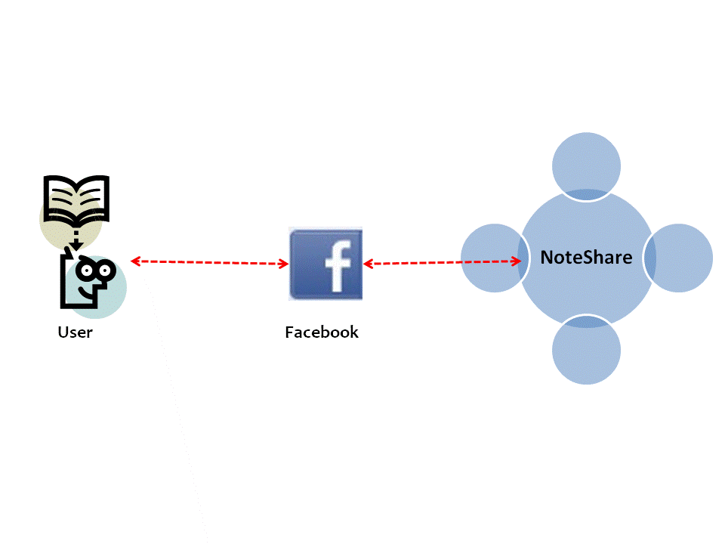
High-Level System Architecture

Slide 4
Component Overview

Slide 5
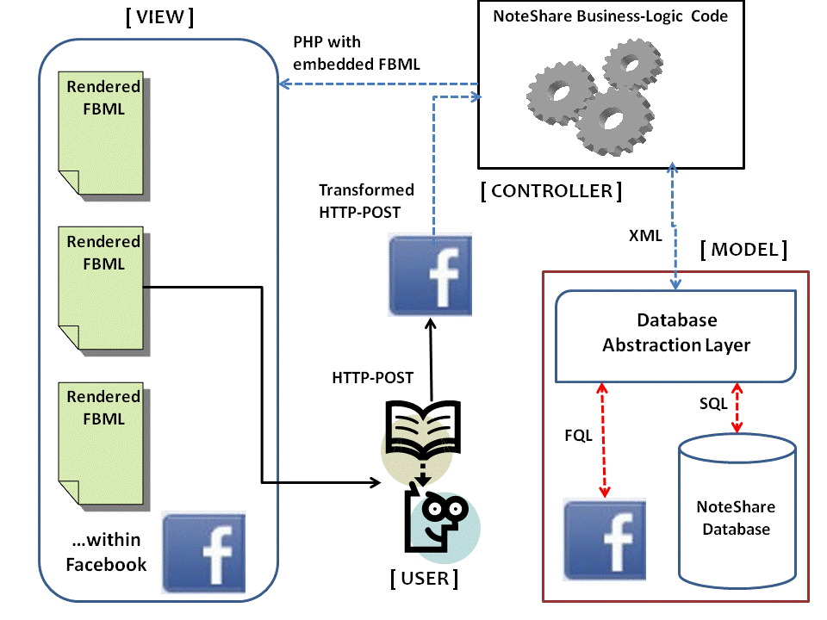
Component View/Interfaces
Some sort of note on Interfaces needs to go here!!!!

Slide 6
Sequence Diagram
There will be more than one…add more slides

Slide 7
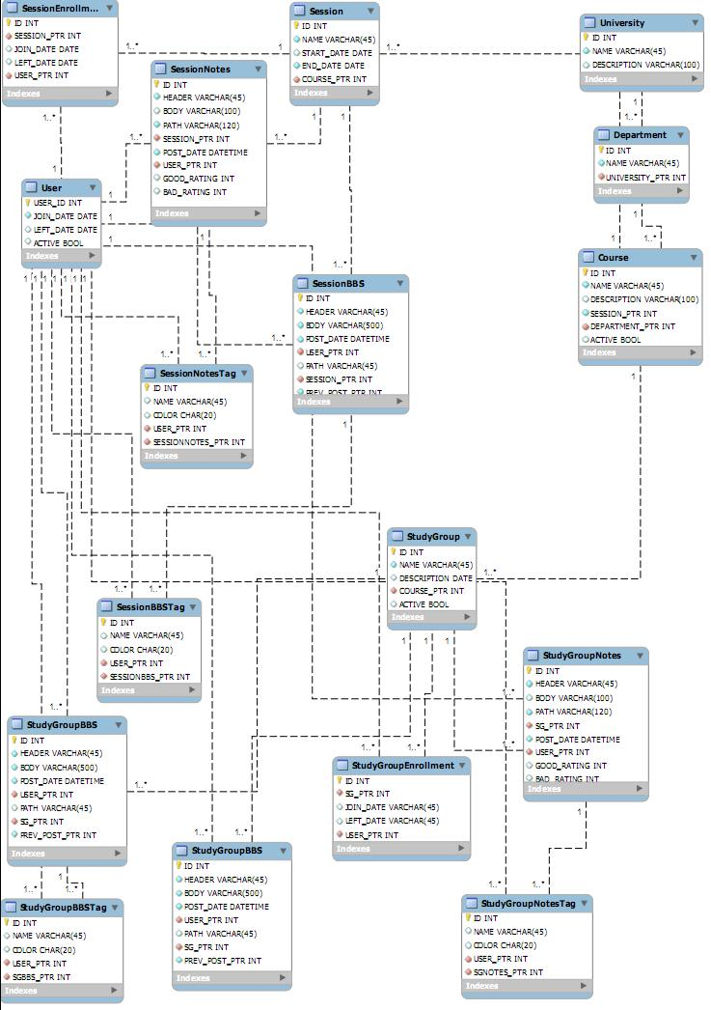
ER Diagram

Slide 8
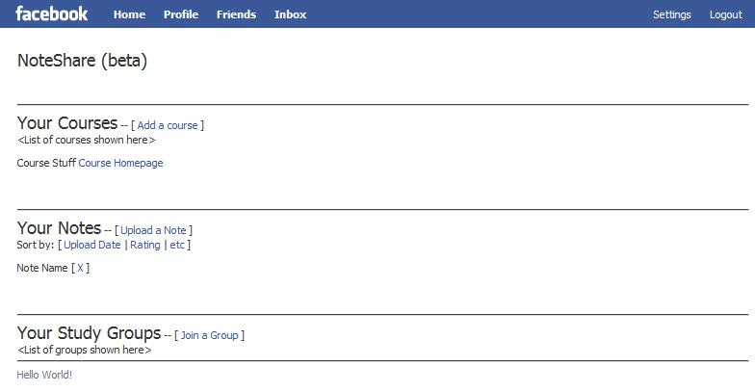
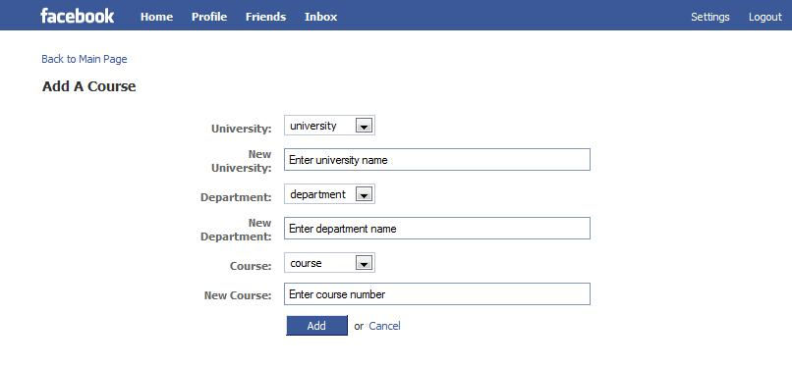
Mock-ups

Slide 9
Questions?

